Slide 1
PREPARED &PRESENTED BY:
ISMAT ARA MAMATAZ
Assistant Teacher (English)
Dhanmondi Govt. Boys’ High School
Dhanmondi, Dhaka-1207

Slide 3
GOOD AFTERNOON
WELCOME TO MY GRAMMAR CLASS
Class viii

Slide 4
Let’s enjoy a video.
http://www.youtube.com/watch?v=7MKmbyfhkkE fun action verb song
After watching the video, you will
Tell me what can you see in the video?
Notes:
4/5 learners will be invited to say some thing on the video.

Slide 5
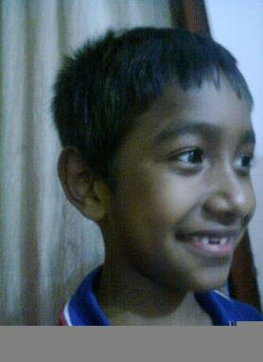
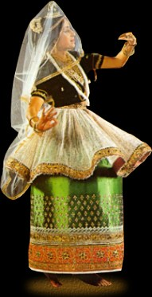
TODAY’S TOPIC
VERBS
Notes:
The learners will be asked to answer what they see in the pictures so that they can mention some actions.

Slide 6
LEARNING OUTCOMES
By the end of the lesson the learners will be able to
define and identify verbs
fill in the gaps with them.
make sensible sentences using different kinds of verbs

Slide 7
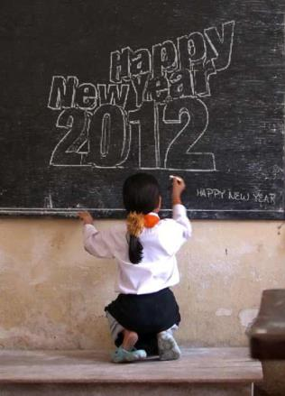
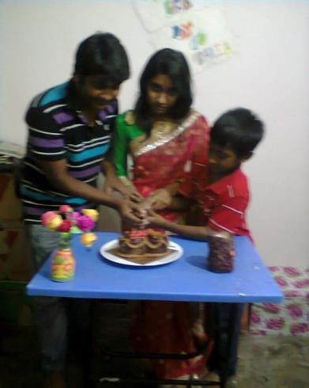
The girl writes on the blackboard.
Spriha is cutting a cake.
Principal verb
Auxiliary Verb
Generally a principal verb sits before the object in
the indefinite tenses,
Always an auxiliary verb sits before a
Principal verb.
Notes:
Learners will be invited to make sentences. Following the given sentences.

Slide 8
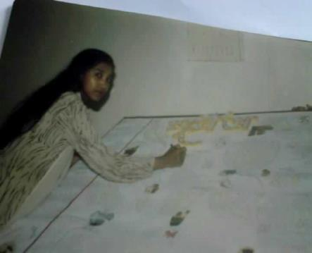
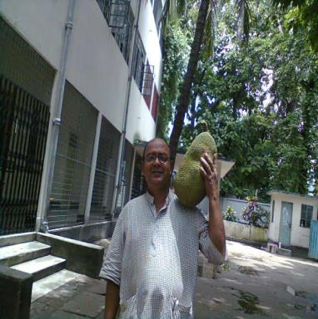
Jesmine writes an editorial.
Mr. Komol likes to eat jackfruits. .
Finite verb
Jesmine wrote an editorial.
Infinitive
Mr.Komol liked to eat jackfruits.
Finite verb
Infinitive
Finite verbs is changed 1.according to the subject’s number & person,
2.Verb’s tense formation.
Infinitives remain unchanged in all cases.
Notes:
Showing the pictures the teacher may ask them to make sentences. After that he/she can explain .

Slide 9
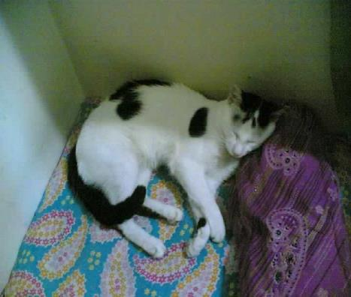
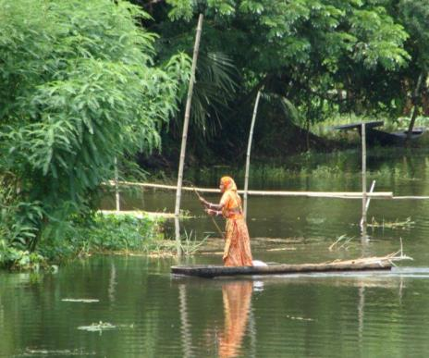
Pao now.
is crossing
is sleeping
The woman the cannel.
Intransitive verb
Transitive verb
An intransitive verb doesn’t have
any object.
A transitive verb has an object.
Notes:
The learners will be asked to fill in the blanks.

Slide 10
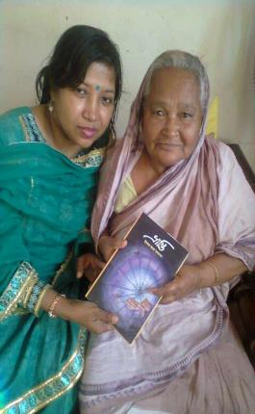
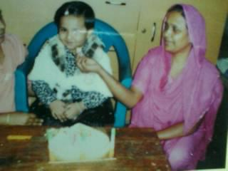
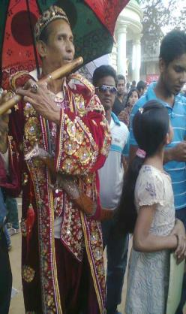
Mrs.Parveen feeds Mohona.
Cognate verb
The piper plays on a flute.
Jesmine gave a Bangla novel, Vranti,
To her aunt.
The verb ‘feed’ comes
from the noun ‘food’.
Group verb
Direct object
Indirect object
Jesmine gave her aunt a Bangla novel, Vranti.
A group verb is followed by a
Preposition.
Notes:
At first 3-4 learners will be invited to make sentences seeing the pictures one by one.

Slide 11
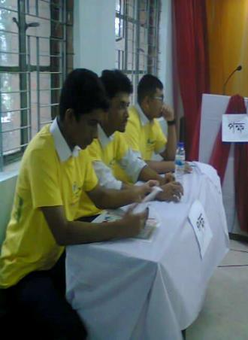
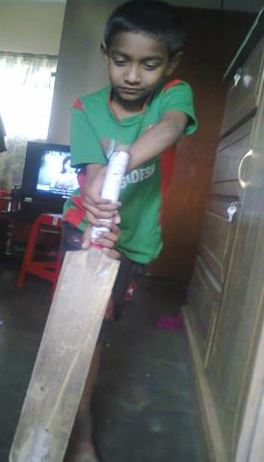
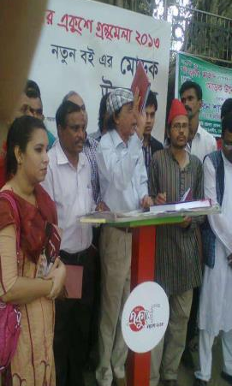
Group work
Describe the pictures and match the following verbs with given pictures and make 5 sensible sentences each using right form the verbs.
play, debate, unveil,

Slide 12
Verbs at a glance
A verb Is an action word.`
Verbs
Principal
Auxiliary
Finite
Non Finite/
Infinitive
Normal
Modals
Transitive
Intransitive
More verbs: Cognate, Group Verbs etc.

Slide 13
Home Work
Write a paragraph on
“The life of a woman in Bangladesh”
using following verbs:
educate, lead ,lag behind, tolerate, torture ,establish ,manage,

Slide 14
Acknowledgement
MoE, DSHE, NCTB & A2I respective officials
And the editors panel:
Mr. Ranjit Poddar, Associate Prof, TTC, Dhaka,
Mr. Md. Jahangir Hasan, Asst. Prof, TTC, Rangpur,
Urmila Khaled Asst. Prof, TTC, Dhaka.
Their direction, valuable suggestions and intensive supervision have enriched the model contents.

